Slide 1
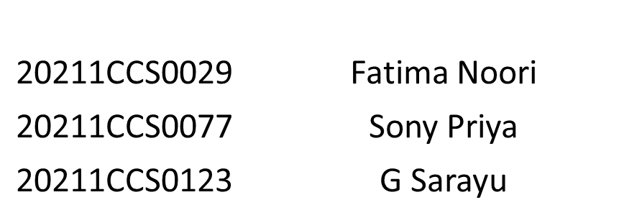
Fake Social Media Profile Detection and Reporting
CSE7301 Project
Final Review
Batch Number: CCS-19
Under the Supervision of,
Ms. Bhavya B
Professor / Associate Professor / Assistant Professor
School of Computer Science and Engineering
Presidency University
Roll Number | Student Name
Name of the Program: B.Tech.
Name of the HoD: Dr. Anandaraj S P
Name of the Program Project Coordinator: Dr. Sharmasth Vali Y
Name of the School Project Coordinators: Dr. Sampath A K / Dr. Abdul Khadar A / Mr. Md Ziaur Rahman

Slide 2
Introduction
Social media has revolutionized communication, but it has also given rise to fake profiles that pose serious threats, including misinformation, cyber fraud, phishing attacks, and identity theft. Malicious actors create these accounts to manipulate public opinion, scam users, or engage in unethical activities, making it crucial to develop effective detection and reporting mechanisms.
This project focuses on building an AI-powered system that automatically identifies and flags suspicious profiles based on behavioral patterns, profile details, and user interactions. Using machine learning algorithms, the system will analyze factors such as posting frequency, engagement metrics, profile authenticity, and content consistency to detect fraudulent accounts.
The goal is to enhance digital security, minimize online risks, and provide social media platforms with an efficient way to combat fake accounts, ultimately ensuring a safer and more trustworthy online environment.

Slide 3
Literature Review
"Fake account detection in social media using machine learning methods: literature review" by Nalia Graciella Kerrysa and Ika Qutsiati Utami (2023). This paper provides a comprehensive review of various machine learning algorithms and methods used to identify fake accounts on platforms like Twitter, Instagram, and Facebook. ​
"A Comprehensive review of fake news detection on social media: feature engineering, feature fusion, and future research directions" by Deepti Nikumbh and Anuradha Thakare (2023). This article discusses state-of-the-art methods for fake news detection, emphasizing the importance of feature engineering and fusion, and highlights future research directions in the field. ​
"Detecting Fake Social Media Profiles Using the Majority Voting Approach" by Dharmaraj R. Patil et al. (2024). This study introduces an innovative approach for discerning and categorizing counterfeit social media profiles by leveraging the majority voting approach, integrating various machine learning algorithms to capture distinct facets of user behavior and profile attributes. ​
"Fake social media news and distorted campaign detection framework using sentiment analysis & machine learning" by Akashdeep Bhardwaj and SeongKi Kim (2024). This research presents a framework using sentiment analysis based on emotions to investigate news, posts, and opinions on social media, aiming to detect fake or spam content and bot accounts. ​

Slide 4
Literature Review
"AI-Fakes Detection Is Failing Voters in the Global South" by Karen Hao (2024). This article discusses the challenges in detecting AI-generated content in the Global South due to biases in AI training systems, which prioritize data from Western markets, leading to inaccuracies in identifying AI manipulation for non-Western content. ​
"Fake News Detection on Social Media: A Data Mining Perspective" by Kai Shu et al. (2017). This survey provides a comprehensive overview of detecting fake news on social media from a data mining perspective, discussing characterization, detection methods, and related research areas.​
"The Spread of Fake News by Social Bots" by Chengcheng Shao et al. (2018). This study investigates the role of social bots in spreading fake news on social media, analyzing their influence and the challenges they pose to detection mechanisms.​
"Fake News Detection: A Deep Learning Approach" by Yaqing Zhou and Reza Zafarani (2018). This paper explores the application of deep learning techniques in detecting fake news on social media platforms, highlighting the effectiveness of neural networks in this domain.​

Slide 5
Literature Review
"The trouble with deepfakes — Beyond control?" by Hannah Murphy (2024). This podcast episode explores the troubling rise of deepfake technology and its implications, particularly focusing on the areas of politics and pornography, and discusses potential solutions like watermarking and detection software. ​
"A Survey on Fake News Detection: From Traditional Machine Learning to Deep Learning" by Shuai Zhang et al. (2020). This survey reviews various fake news detection methods, transitioning from traditional machine learning approaches to advanced deep learning techniques, and discusses their effectiveness and limitations.​

Slide 6
Existing method Drawback
Despite the progress in fake profile detection, existing methods have several limitations.
Graph-Based Methods:
Limited in Complex Networks: These methods may fail in highly interconnected or intricate networks where fake accounts closely mimic legitimate profiles.
Scalability Issues: As social networks grow, these approaches may become computationally expensive, making them less efficient for large-scale platforms.
Hybrid Methods:
Complex Implementation: Combining graph-based and machine learning methods can be resource-intensive and difficult to implement effectively.
Balancing Trade-Offs: While hybrid methods can be more accurate, they may still face challenges in terms of scalability and real-time detection.

Slide 7
Existing method Drawback
Machine Learning Techniques:
- Data Quality and Quantity: Supervised learning models require large, high-quality labeled datasets, which are often difficult to obtain.
- Feature Engineering Challenges: Effective feature extraction is a key challenge; if features are poorly designed, model performance suffers.
- Adaptability to Evolving Tactics: Machine learning models may struggle to adapt quickly to new, more sophisticated fake profile tactics.

Slide 8
Proposed Method
Hybrid Approach:
Combination of Natural Language Processing, Logistic Regression and Artificial Neural Network
Leverage the strengths of both approaches to improve accuracy and adaptability.
Dynamic Feature Extraction:
Behavioral Analysis: Continuously monitor user activity patterns, engagement behavior, and interaction frequency to identify anomalies.
Contextual Data Integration: Use temporal, geographical, and social context to validate profile authenticity.
Scalability:
Efficient Algorithms: Design methods that scale efficiently with growing platform sizes, optimizing for both accuracy and computational efficiency.

Slide 9
Proposed Method
Real-Time Detection:
Streamlined Analysis: Implement algorithms capable of processing data in real time, flagging suspicious profiles as they emerge.
Automated Reporting System: Integrate with automated reporting tools that instantly notify platform moderators of suspicious activity.
Adaptability to New Tactics:
Machine Learning Retraining: Continuously retrain models to adapt to new fraudulent tactics and ensure long-term accuracy.
User Feedback Integration: Incorporate user reports as an additional validation layer, refining the detection process.

Slide 10
Objectives
Enhance Detection Accuracy:
Develop a hybrid model combining graph-based and machine learning techniques to improve the detection of fake profiles.
Real-Time Detection and Reporting:
Implement systems for detecting suspicious profiles and generating reports instantly to ensure timely intervention.
Adaptability to Emerging Threats:
Create a system that can evolve with new fake profile tactics by continuously retraining models and incorporating user feedback.
Scalable and Efficient Algorithms:
Design algorithms that maintain high detection performance while scaling efficiently for large social media platforms.
Privacy-Preserving Approach:
Ensure that the detection process respects user privacy while effectively identifying fraudulent accounts.

Slide 11
Methodology
Data Collection:
Gather large-scale social media data, including user profiles, activity logs, and interactions.
Feature Extraction:
Extract dynamic features like posting behavior, engagement patterns, and network connectivity.
Model Training:
Apply machine learning techniques (supervised/unsupervised) to train models using extracted features.
Integrate graph-based algorithms to analyze the network structure and identify anomalies.
Real-Time Detection:
Deploy detection algorithms to monitor user activity in real time.
System Feedback:
Continuously improve detection accuracy by incorporating user feedback and retraining models.

Slide 12
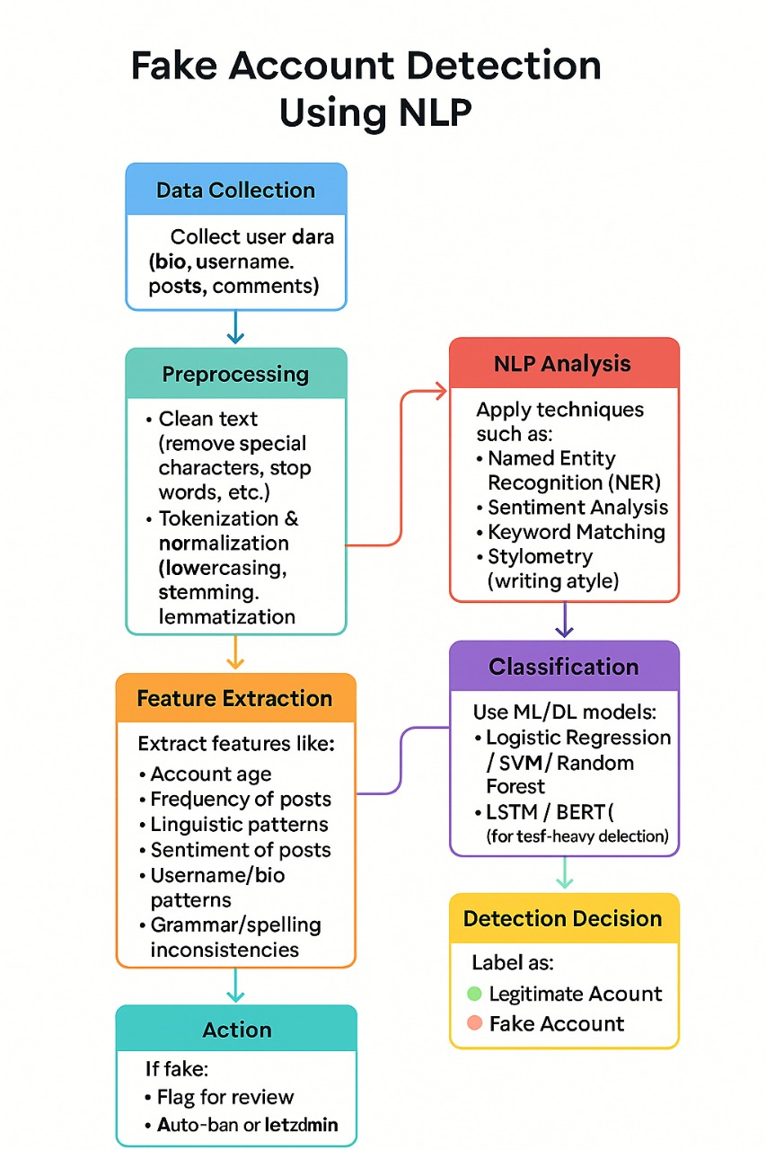
Architecture

Slide 13
Architecture
Key Components:
Data Collection Module:
Function: Collects raw data from social media platforms, including user profiles, posts, interactions, and metadata.
Input: Social media platform data (user profiles, activities).
Output: Cleaned, preprocessed data ready for analysis.
Feature Engineering Module:
Function: Extracts relevant features from collected data (e.g., engagement patterns, posting behavior, network structure).
Input: Raw data from the Data Collection Module.
Output: Feature vectors representing user activity and behavior.

Slide 14
Architecture
Detection Module:
Function: Combines machine learning models and graph-based algorithms to identify fake profiles by analyzing features and network patterns.
Input: Feature vectors from Feature Engineering.
Output: Suspicious profiles flagged for further review.
Reporting Module:
Function: Automatically flags suspicious profiles and generates reports for platform moderators.
Input: Suspicious profiles identified by the Detection Module.
Output: Reports sent to platform moderators for investigation.
Feedback and Adaptation Module:
Function: Collects feedback from users and moderators to improve the detection models. Incorporates new fraudulent tactics into the training set.
Input: Feedback from moderators, users, and detection outcomes.
Output: Updated models for more accurate detection.

Slide 15
Data Flow:
Data Collection → Collects data from social media platforms.
Feature Engineering → Extracts features from collected data.
Detection → Applies machine learning and graph algorithms to detect fake profiles.
Reporting → Flags suspicious profiles and generates reports for moderators.
Feedback & Adaptation → Refines detection models based on feedback for continuous improvement.

Slide 16
Sofware Components
Frontend Development
React.js / Angular – For building an intuitive user interface.
HTML, CSS, JavaScript – For responsive and interactive design.
Backend Development
Node.js / Flask– For handling business logic and API requests.
REST APIs – For efficient communication between frontend and backend.
Database Management
SQL - For storing user data, reports, and detection logs.
Artificial Intelligence & Machine Learning
Python (TensorFlow, Scikit-learn, OpenCV, NLP libraries) – For profile detection and behavior analysis.
Deep Learning Models – To detect fake images, bots, and unnatural activity patterns.

Slide 17
Sofware Components
Cloud & Hosting Services
AWS / Google Cloud– For scalable cloud infrastructure.
Docker & Kubernetes – For containerization and deployment.
Security & Privacy
OAuth 2.0 – For secure authentication.
Encryption (AES, RSA) – To protect sensitive user data.
Reporting & Monitoring Tools
Elasticsearch & Kibana – For real-time data analysis and monitoring.
Google Analytics & Firebase Analytics – For tracking suspicious activity patterns.

Slide 18
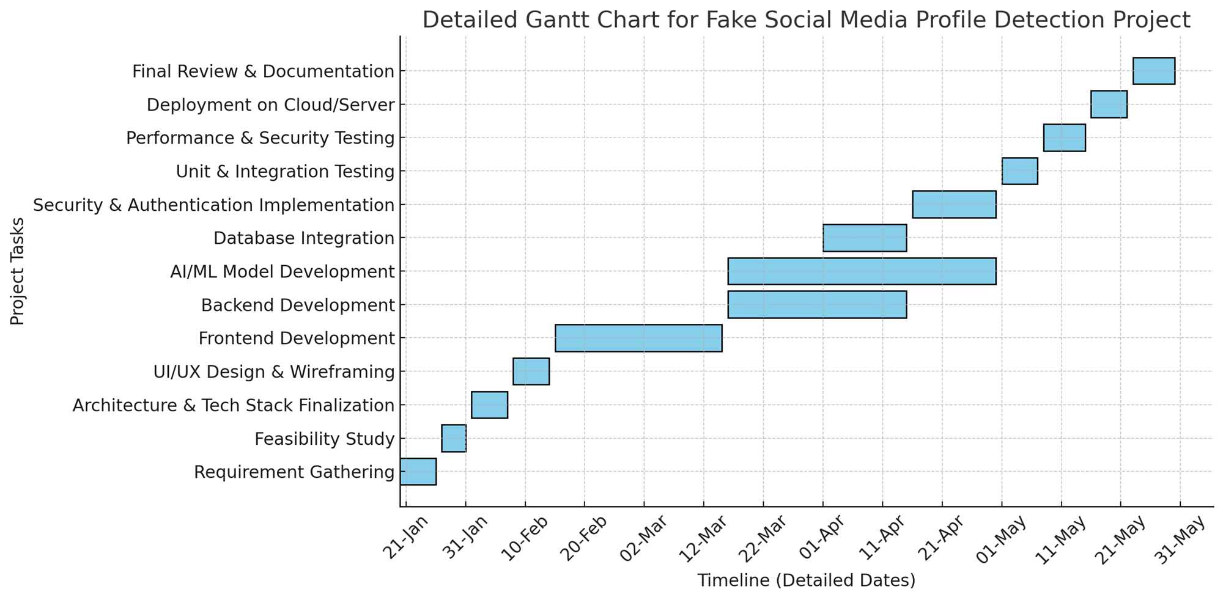
Timeline of Project

Slide 19
Expected Outcomes
Accurate Detection of Fake Profiles:
High accuracy in identifying fake profiles based on behavioral analysis, network structure, and engagement patterns.
Real-Time Profiling:
Ability to flag suspicious accounts instantly as they exhibit abnormal behavior, ensuring prompt action.
Scalable Detection System:
A solution that can handle large-scale data from multiple social media platforms without significant performance degradation.
Continuous Model Improvement:
Ongoing adaptation to new fraud tactics based on user feedback, evolving detection techniques, and dynamic feature updates.
Automated Reporting:
Efficient reporting of suspicious profiles to moderators, streamlining the moderation process and reducing manual intervention.

Slide 20
Conclusion
In conclusion, the proposed hybrid approach, Logistic Regression and Artificial Neural Network, provides a robust and effective solution for detecting fake social media profiles.
By enabling real-time detection and ensuring scalability, the system can efficiently flag suspicious accounts, even on large platforms. Additionally, the continuous adaptation of the system to emerging fraudulent tactics ensures its long-term effectiveness.
The project’s outcomes contribute significantly to improving the integrity, trust, and security of social media platforms by reducing the influence of fake profiles.
Moreover, the techniques developed have the potential for expansion to address other forms of online fraud, offering broader applications in maintaining a safe and reliable digital environment.

Slide 21
Github Link
Git hub Link
https://github.com/Sony-2002/Fake-Social-Media-Profile-Detection-and-Reporting

Slide 22
References
Douceur, J. R. (2002). The Sybil Attack. Proceedings of the 1st International Workshop on Peer-to-Peer Systems (IPTPS), 251-260.
Zhou, D., & Han, J. (2009). A Survey of Graph-Based Anomaly Detection Techniques. Proceedings of the 9th International Symposium on Advances in Databases (ADB), 1-13.
Wang, W., & Zhang, X. (2016). Fake Account Detection on Social Media Platforms: A Survey. Proceedings of the 2016 IEEE International Conference on Data Mining (ICDM), 1003-1008.
Shao, C., Ciampaglia, G. L., Varol, O., Flammini, A., & Menczer, F. (2017). The Spread of Fake News by Social Bots. Proceedings of the 2017 IEEE/ACM International Conference on Advances in Social Networks Analysis and Mining (ASONAM), 1-8.
Akoglu, L., & Faloutsos, C. (2011). Anomaly Detection in Large-Scale Graphs. Proceedings of the 2011 SIAM International Conference on Data Mining (SDM), 2-13.
Liu, Y., & Chen, M. (2018). Machine Learning for Social Media Fake Account Detection: A Survey. Journal of Computational Science, 24(2), 1-16.
Feng, Y., & Li, W. (2020). Fake Profile Detection in Social Networks Using Machine Learning Techniques. Proceedings of the 2020 IEEE 15th International Conference on Software Engineering and Service Science (ICSESS), 229-234.
Srinivasan, A., & Vaidya, J. (2017). Detecting Fake Accounts Using Graph Analysis and User Behavior. Proceedings of the 2017 IEEE/ACM International Conference on Big Data (BigData), 1-6.
Guille, A., Hacid, H., & Finkel, H. (2013). A Survey of Fake Profile Detection Methods in Social Networks. Social Network Analysis and Mining, 3(4), 889-912.
Liu, Q., & Tang, J. (2016). Social Media Fraud Detection: Algorithms and Applications. Proceedings of the 2016 IEEE International Conference on Computational Social Networks (CSoNet), 83-90.

Slide 23
SDG Mapping
This project aligns with the following Sustainable Development Goals (SDGs):
SDG 9: Industry, Innovation, and Infrastructure
Relevance: The project promotes innovation in digital infrastructure by developing advanced algorithms to detect fake profiles, enhancing the integrity of online platforms.
Impact: Contributes to more secure and trustworthy digital environments, fostering the growth of a reliable online economy.
SDG 16: Peace, Justice, and Strong Institutions
Relevance: By reducing the prevalence of fake profiles, the project strengthens the credibility of online platforms and protects users from online fraud and misinformation.
Impact: Supports transparent and accountable institutions by ensuring digital platforms are safer for users and more resistant to abuse.

Slide 24
SDG Mapping
SDG 4: Quality Education
Relevance: The project enhances the field of cybersecurity, providing insights into detecting online fraud that can be used in educational curricula related to social media security.
Impact: Contributes to improved knowledge on online safety and digital literacy, crucial for educators and learners in the tech field.
SDG 17: Partnerships for the Goals
Relevance: Collaboration between academia, technology companies, and social media platforms is key for implementing the fake profile detection system effectively.
Impact: Promotes partnerships and multi-stakeholder cooperation to achieve collective goals of improving online security.

Slide 25
Thank You

